Slide 1
Introduction
to Programming World

Slide 2
Introduction to Programming
CGDC
Computer is an electronic device used for storing and processing information. Most computers follow the basic principle of output, process, and output for any problem. To perform these input, process, and output activities, computers need a set of instructions called a program.
Who is a Programmer?
A programmer is a person who writes the required computer programs.
Programmers translate the expected tasks given in human understandable form into machine understandable form by using compilers and interpreters.

Slide 3
Compiler & Interpreter
Compiler is a specific software that gets the whole Source Code (Computer program written in human understandable form) and translates it into Object Code (Computer Program that is in machine understandable form) all at a time.
Interpreter is translating and executing one statement (command of Computer Program) of Source Code into Object Code at a time. (It means, interpreters translate and execute computer programs line by line).

Slide 4
CGDC
Well designed programs must be:
  Correct and accurate
  Easy to understand
  Easy to maintain and update
  Efficient
  Reliable
  flexible

Slide 5
CGDC
  Problem definition
  What must the program do?
  What outputs are required and in what form?
  What inputs are available and in what form?
  For Example: Find a maximum of two numbers
  Input two numbers, compare them and print the maximum value
  Inputs and outputs are decimal numbers
  Inputs are entered from the keyboard
  Result is shown on the monitor

Slide 6
Programming Process
Program Design
This involves creating an algorithm – sequence of steps, by which a computer can produce the required outputs from the available inputs
Top-down design
  The main problem is split into subtasks
  Then each subtask is divided into simpler subtasks, etc. unless it is clear how to solve all such subtasks

Slide 7
Programming Process
Program Compilation
Translation of a program written in a high-level programming language into machine language instruction.
Compilation step converts a source program into an intermediate form, called object code
Linking step is necessary to combine this object code with other code to produce an executable program
The advantage of this two-step approach:
  Source of the large program may be split into more than one file
  These files are worked on and compiled separately
  Object code may be stored in libraries and used for many programs
  Then they will be combined into one executable code

Slide 8
Programming Process
CGDC
Program Testing & Debugging
  Initially, almost all programs may contain a few errors, or bugs
  Testing is necessary to find out if the program produces a correct result. Usually it is performed with sample data
  Debugging is the process of locating and removing errors

Slide 9
Types of Programming Languages
CGDC
  Low-level languages (Machine Lang., Assembly Lang.).
    Machine language
      made up of binary 1s and 0s
      this is the only programming language the computers can understand
      advantages of machine languages are:
        fast execution speed
        efficient use of main memory
      disadvantages of machine languages are:
        writing machine language is tedious
        difficult and time consuming

Slide 10
Types of Programming Languages
CGDC
Assembly Language
  Writing programs can be very time-consuming, as you have to directly manipulate CPU registers and use complicated interfaces to I/O devices
  Code is assembled to make Machine Language (consisting only of 1’s and 0’s) which is the real language of the CPU

Slide 11
Types of Programming Languages
CGDC
  High Level Languages
  user friendly
  needs less programming time
  and it is more easier to develop a program
  slower
  needs more resources .
Major high-level languages are
  FORTRAN, COBOL, BASIC, PASCAL, C, C++, C#, JAVA etc.

Slide 12
Other High-level Languages
CGDC
  FORTRAN
  Formula Translator
  1954-1957: IBM
  Complex mathematical computations
  Scientific and engineering applications
  COBOL
  Common Business Oriented Language
  1959
  Computer manufacturers, government
  & Industrial computer users
  Precise and efficient manipulation of large amounts of data.
PASCAL
  Prof. Niklaus Wirth
  Academic use

Slide 13
Programming and Procedure of Problem Solving
CGDC
Programming task can be made easier by breaking large and complex programs into smaller and less complex subprograms (modules)
Programming task can be separated into 2 phases.
problem solving phase
  produce an ordered sequence of steps that describe solution of problem
  this sequence of steps is called an algorithm
implementation phase
  implement the program in some programming language (Pascal, Basic, C)

Slide 14
Procedure of problem solving
Problem solving is mainly achieved by the following two ways:
Algorithm
Flowchart

Slide 15
Algorithms for problem solving
These are generally a set of instructions which describes the steps to be followed to get the solution of a problem.
Characteristics of Algorithm :
  Every instructions has to be precise and unambiguous.
  Each instructions should be such that it can be performed in a finite time.
  One or more instructions should not be repeated infinitely.
  After performing the instructions, that is, after algorithm terminates, the desired results must be obtained.

Slide 16
Advantages of Algorithm
It is a step-by-step solution to the problem and is easy to understand
It is independent of programming languages.
It could to easily coded into its equivalent high-level languages.
Debugging is easy.

Slide 17
Algorithm Examples
Q. Write an algorithm to find out the largest number between two numbers.
Soln.
Step 1. Begin.
Step 2. Declare n1 and n2 as two integer variable.
Step 3. Accept the value of n1 and n2.
Step 4. Check which number is larger.
Step 5. Display the largest number.
Step 6. Stop.

Slide 18
Flowchart
This also represent solution to a problem as like algorithm but in a graphical presentation.
Flowchart generally displays sequence of operation/instructions to achieve/perform certain task.
Here the instructions are denoted by the boxes of various shapes designed for different purposes.
And the instructions are actually embedded in to the boxes itself in a meaningful statement.

Slide 19
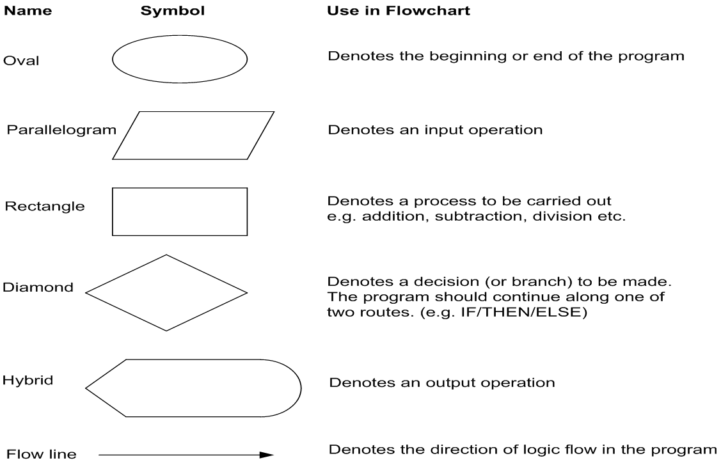
Flowchart is a diagrammatic representation of an algorithm. Flowchart are very helpful in writing program and explaining program to others.
Symbols Used In Flowchart

